Slide 1
Lab 1
Yao zhao

Slide 2
Lab1.A
https://lms.sustech.cloud/problem/128

Slide 3
Input：
Tree：
16 5
mkdir a
echo 123 > a/b
echo 234 > a/c
echo 345 > a/d
mkdir b
mkdir c
mkdir d
echo 666 > b/a
echo 23333 > c/a
echo 12312dasdasdf > d/a
mkdir a/e
echo > a/e/b
echo > b/b
echo > d/b
rm a/c
rm -rf a/e
cat d/a
cat c/a
find
find a -name b
find ././././ -name b -type f
.
├── a
│ ├── b
│ └── d
├── b
│ ├── a
│ └── b
├── c
│ └── a
└── d
├── a
└── b

Slide 4
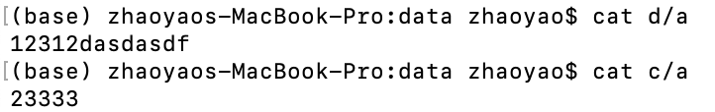
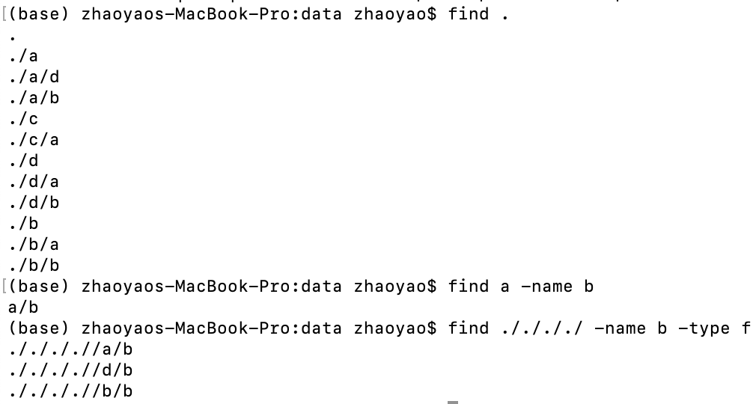

Slide 5
This problem only requires building and traversing a file tree, which can be done using Depth-First Search (DFS).
How to building a tree: to build a tree data structure, you can create a class to represent the nodes of the tree and then establish the parent-child relationships between the nodes.
Tree Node:
name
type
content
Father node
Children list
File or file folder’s name
The node’s type is file or file folder
fields
If The node is file, store the content here, if not a file, the content can be null
Set to null if the node is root
Set to null or set the size is 0 if The node is file

Slide 6
Initial state:
root
name: .
type: folder
content: null
father node: null
children list: null

Slide 7
Input：
Step 1: get node .
Step 2: create a,
Type is folder
Step 3：update the a’s father node and the .’s children list.
root
16 5
mkdir a
echo 123 > a/b
echo 234 > a/c
echo 345 > a/d
mkdir b
mkdir c
mkdir d
echo 666 > b/a
echo 23333 > c/a
echo 12312dasdasdf > d/a
mkdir a/e
echo > a/e/b
echo > b/b
echo > d/b
rm a/c
rm -rf a/e
cat d/a
cat c/a
find
find a -name b
find ././././ -name b -type f
name: .
type: folder
content: null
father node: null
children list:
name: a
type: folder
content: null
father node:
children list: null

Slide 8
Input：
Step 1: get node a
Step 2: create b,
Type is file
Step 3: if [content] is not empty，assign to content
Step 4：update the b’s father node and the a’s children list.
root
16 5
mkdir a
echo 123 > a/b
echo 234 > a/c
echo 345 > a/d
mkdir b
mkdir c
mkdir d
echo 666 > b/a
echo 23333 > c/a
echo 12312dasdasdf > d/a
mkdir a/e
echo > a/e/b
echo > b/b
echo > d/b
rm a/c
rm -rf a/e
cat d/a
cat c/a
find
find a -name b
find ././././ -name b -type f
name: .
type: folder
content: null
father node: null
children list:
name: a
type: folder
content: null
father node:
children list:
name: b
type: file
content: 123
father node:
children list: null

Slide 9
Input：
Step 1: get node a and a/c
Step 2: delete the node c
Step 3: update the a’s children list.
root
16 5
mkdir a
echo 123 > a/b
echo 234 > a/c
echo 345 > a/d
mkdir b
mkdir c
mkdir d
echo 666 > b/a
echo 23333 > c/a
echo 12312dasdasdf > d/a
mkdir a/e
echo > a/e/b
echo > b/b
echo > d/b
rm a/c
rm -rf a/e
cat d/a
cat c/a
find
find a -name b
find ././././ -name b -type f
name: .
type: folder
content: null
father node: null
children list:
name: a
type: folder
content: null
father node:
children list:
……
name: c
type: file
content: 234
father node:
children list: null
……

Slide 10
Input：
Step 1: get node a and a/e
Step 2: delete the subtree e
Step 3: update the a’s children list.
root
16 5
mkdir a
echo 123 > a/b
echo 234 > a/c
echo 345 > a/d
mkdir b
mkdir c
mkdir d
echo 666 > b/a
echo 23333 > c/a
echo 12312dasdasdf > d/a
mkdir a/e
echo > a/e/b
echo > b/b
echo > d/b
rm a/c
rm -rf a/e
cat d/a
cat c/a
find
find a -name b
find ././././ -name b -type f
name: .
type: folder
content: null
father node: null
children list:
name: a
type: folder
content: null
father node:
children list:
……
name: b
type: file
content:
father node:
children list: null
name: e
type: folder
content: 234
father node:
children list:
……

Slide 11
Input：
Step 1: get node a and b and b’s father node .
Step 2:update .’s children list
Step 3: update b’s father node
Step 3: update the a’s children list.
root
16 5
mkdir a
echo 123 > a/b
echo 234 > a/c
echo 345 > a/d
mkdir b
mkdir c
mkdir d
echo 666 > b/a
echo 23333 > c/a
echo 12312dasdasdf > d/a
mkdir a/e
echo > a/e/b
echo > b/b
echo > d/b
rm a/c
rm -rf a/e
mv b a
cat d/a
cat c/a
find
find a -name b
find ././././ -name b -type f
name: .
type: folder
content: null
father node: null
children list:
name: a
type: folder
content: null
father node:
children list:
……
name: b
type: folder
content:
father node:
children list:
……
……

Slide 12
Input：
Step 1: get node a and b and b’s father node .
Step 2:update .’s children list
Step 3: update b’s father node
Step 3: update the a’s children list.
root
16 5
mkdir a
echo 123 > a/b
echo 234 > a/c
echo 345 > a/d
mkdir b
mkdir c
mkdir d
echo 666 > b/a
echo 23333 > c/a
echo 12312dasdasdf > d/a
mkdir a/e
echo > a/e/b
echo > b/b
echo > d/b
rm a/c
rm -rf a/e
mv b a
cat d/a
cat c/a
find
find a -name b
find ././././ -name b -type f
name: .
type: folder
content: null
father node: null
children list:
name: a
type: folder
content: null
father node:
children list:
……
name: b
type: folder
content:
father node:
children list:
……
……

Slide 13
Input：
Step 1: get node a and b and b’s father node .
Step 2:update .’s children list
Step 3: update b’s father node
Step 3: update the a’s children list.
root
16 5
mkdir a
echo 123 > a/b
echo 234 > a/c
echo 345 > a/d
mkdir b
mkdir c
mkdir d
echo 666 > b/a
echo 23333 > c/a
echo 12312dasdasdf > d/a
mkdir a/e
echo > a/e/b
echo > b/b
echo > d/b
rm a/c
rm -rf a/e
mv b a
cat d/a
cat c/a
find
find a -name b
find ././././ -name b -type f
name: .
type: folder
content: null
father node: null
children list:
name: a
type: folder
content: null
father node:
children list:
……
name: b
type: folder
content:
father node:
children list:
……
……

Slide 14
Input：
Step 1: get node a and b and b’s father node .
Step 2:update .’s children list
Step 3: update b’s father node
Step 3: update the a’s children list.
root
16 5
mkdir a
echo 123 > a/b
echo 234 > a/c
echo 345 > a/d
mkdir b
mkdir c
mkdir d
echo 666 > b/a
echo 23333 > c/a
echo 12312dasdasdf > d/a
mkdir a/e
echo > a/e/b
echo > b/b
echo > d/b
rm a/c
rm -rf a/e
mv b a
cat d/a
cat c/a
find
find a -name b
find ././././ -name b -type f
name: .
type: folder
content: null
father node: null
children list:
name: a
type: folder
content: null
father node:
children list:
……
name: b
type: folder
content:
father node:
children list:
……
……

Slide 15
Input：
MV final state
root
16 5
mkdir a
echo 123 > a/b
echo 234 > a/c
echo 345 > a/d
mkdir b
mkdir c
mkdir d
echo 666 > b/a
echo 23333 > c/a
echo 12312dasdasdf > d/a
mkdir a/e
echo > a/e/b
echo > b/b
echo > d/b
rm a/c
rm -rf a/e
mv b a
cat d/a
cat c/a
find
find a -name b
find ././././ -name b -type f
name: .
type: folder
content: null
father node: null
children list:
name: a
type: folder
content: null
father node:
children list:
……
name: b
type: folder
content:
father node:
children list:
……
……

Slide 16
Input：
16 5
mkdir a
echo 123 > a/b
echo 234 > a/c
echo 345 > a/d
mkdir b
mkdir c
mkdir d
echo 666 > b/a
echo 23333 > c/a
echo 12312dasdasdf > d/a
mkdir a/e
echo > a/e/b
echo > b/b
echo > d/b
rm a/c
rm -rf a/e
cat d/a
cat c/a
find
find a -name b
find ././././ -name b -type f
cat
Step 1: get node according the path
Step 2: if the content is empty, just output “\n”, else output the content.

Slide 17
Input：
16 5
mkdir a
echo 123 > a/b
echo 234 > a/c
echo 345 > a/d
mkdir b
mkdir c
mkdir d
echo 666 > b/a
echo 23333 > c/a
echo 12312dasdasdf > d/a
mkdir a/e
echo > a/e/b
echo > b/b
echo > d/b
rm a/c
rm -rf a/e
cat d/a
cat c/a
find
find a -name b
find ././././ -name b -type f
find [path] [expression]
Step 1: get node according the path, if path is empty, the node is root(.)
Step 2: if the expression is not null, check if the node satisfy the expression.
Step 3: if the node has children, recursively find it’s each child.

Slide 18
parse the arguments:
String api:
public String[] split(String regex)
public String trim()

Slide 19
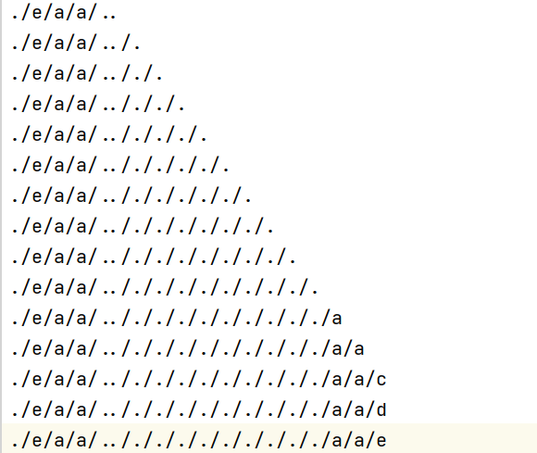

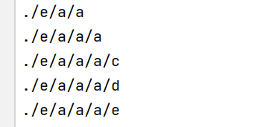
“.” &“..”
when we use command “echo”,”rm”,we should simplify path, if not execute “find” , you will get below:

Slide 20
Lab1.B
Given an undirected connected graph G with n nodes and m edges. Nodes are numbered starting from 1 to n .
Given two integers a, b . Now counting the pairs (x, y) that any path from node x to node y goes through node a and node b (x ≠ a, x ≠ b, y ≠ a, y ≠ b) .
Print the required number of pairs. The order of two nodes in a pair does not matter, that is, the pairs (x, y) and (y, x) must be taken into account only once.

Slide 21
Input：
7 7 3 5
5 6
6 7
7 5
1 2
2 3
3 4
4 5
2
1
6
7
3
4
5
Pairs:
(1, 6) (2, 6)
(1, 7) (2, 7)
Output：
4

Slide 22
Input：
7 8 3 5
5 6
6 7
7 5
1 2
2 3
3 4
4 5
1 6
2
1
6
7
3
4
5
For (1, 6):
Exist 3 Paths: (1, 6) and (1,2,3,4,5,6) and (1,2,3,4,5,7,6)
2
1
6
2
1
6
7
7
Output：
3
4
5
3
4
5
0
2
1
6
Path(1, 6) not go through the node 3 and node 5, so not satisfy the requirement.
In this graph, no pair satisfies the requirement, output 0.
7
3
4
5

Slide 23
Lab1.B Solution
since for the pair (x, y), all path from x to y should go through a, b, so we know, if no a, x can’t reach b, if no b, y can’t reach a.

Slide 24
Assume the node b removed from the graph, search from the node a,
we can reach node 1,2,4, can not reach 6,7.
2
1
6
7
3
4
5

Slide 25
Assume the node a removed from the graph, search from the node b,
we can reach node 4,6,7, can not reach 1,2.
2
1
6
7
3
4
5

